Slide 1
Analysis Case Study: Cyclistic Bike-Share
Paulina Remis
Last Updated: August 2023

Slide 2
Table of Contents
Introduction
Project Overview and Goals
Data and Analysis
Key insights & Conclusions
Recommendations & Actionable Steps

Slide 3
What is Cyclistic?

Slide 4
Cyclistic
Setting
Based in Chicago, IL
Over 692 Stations
How it Works
Bikes are unlocked from one stations
The bikes are returned to any other station in the system
Types of Riders
Members – annual membership
Casual Riders – single-ride passes or full-day passes
Mostly used for leisure, 30% use them to commute to work

Slide 5
Where did the data come from?

Slide 6
Data
Availability
The data was made available through this license
Range
January 2022- December 2022
Limitations
Data-privacy issues prohibit you from using riders’ personally identifiable information.
Available through this link

Slide 7
What is the purpose?

Slide 8
Overview
Business Task
Identify trends in how casual riders and annual members use the Cyclistic bikes differently
Analyze which factors could influence a casual rider's decision to buy an annual membership
Provide high quality recommendations for the marketing team to convert casual riders into annual members
Key Stakeholders
Lily Moreno - director of marketing and your manager
Cyclistic marketing analytics team
Cyclistic executive team

Slide 9
Data and Analysis

Slide 10
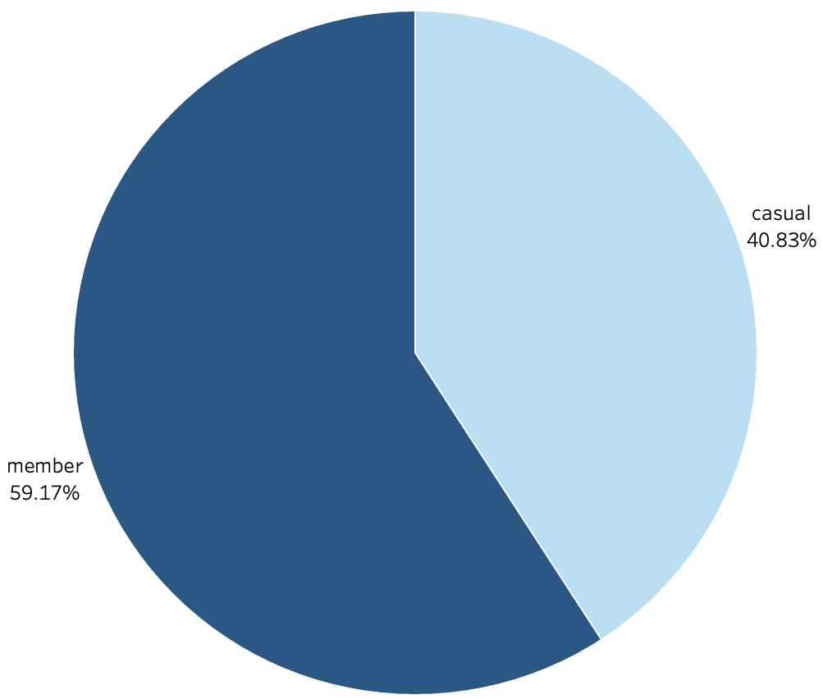
Ride Distribution
Members are responsible for the majority of the rides taken during the year

Slide 11
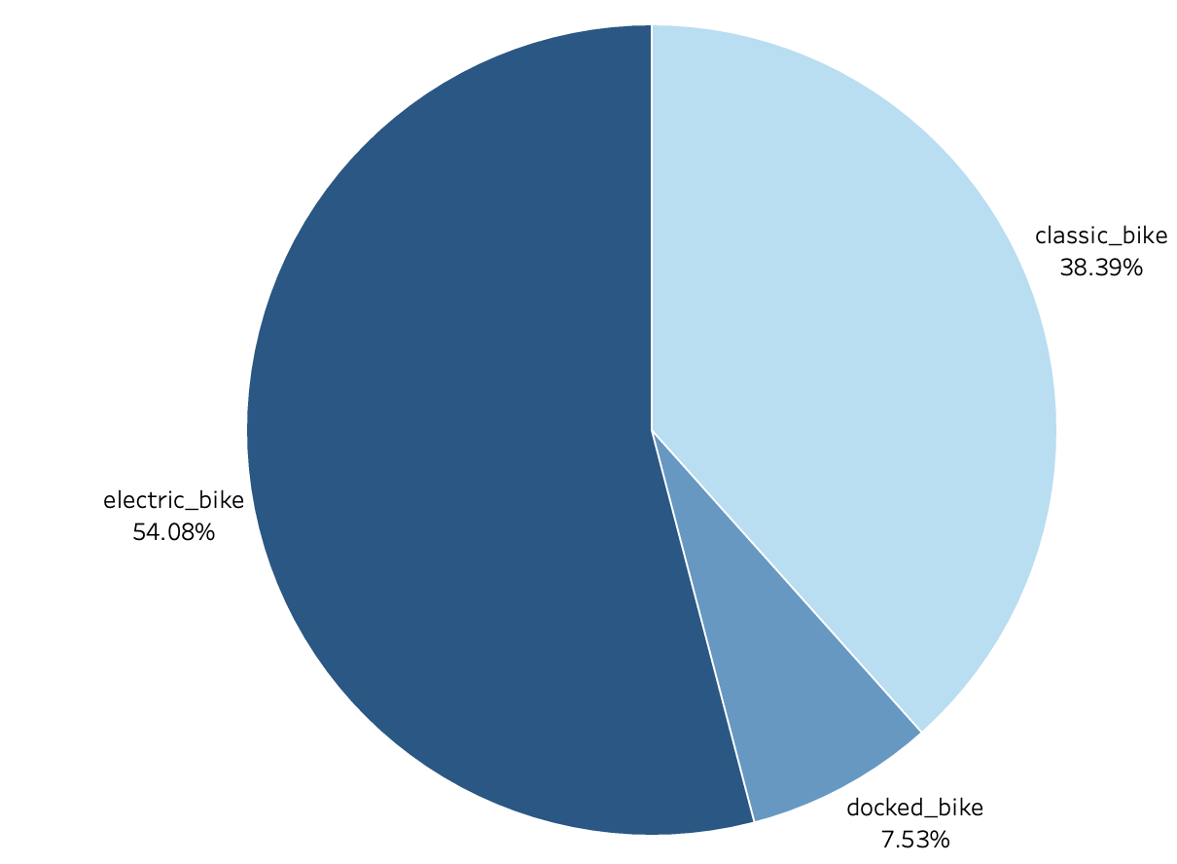
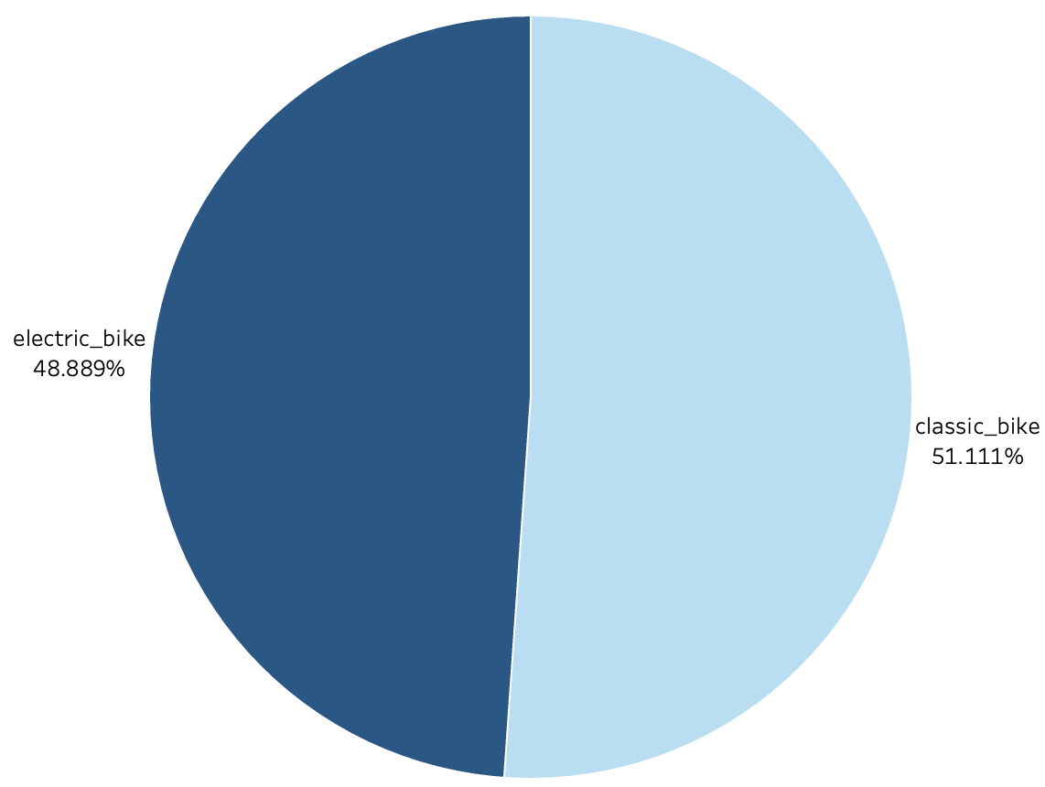
Rideable Type
Casual Riders
The electric bike is preferred by Casual Riders while the Classic Bike is preferred by Members
The Docked Bike is only used by Casual Riders
Members

Slide 12
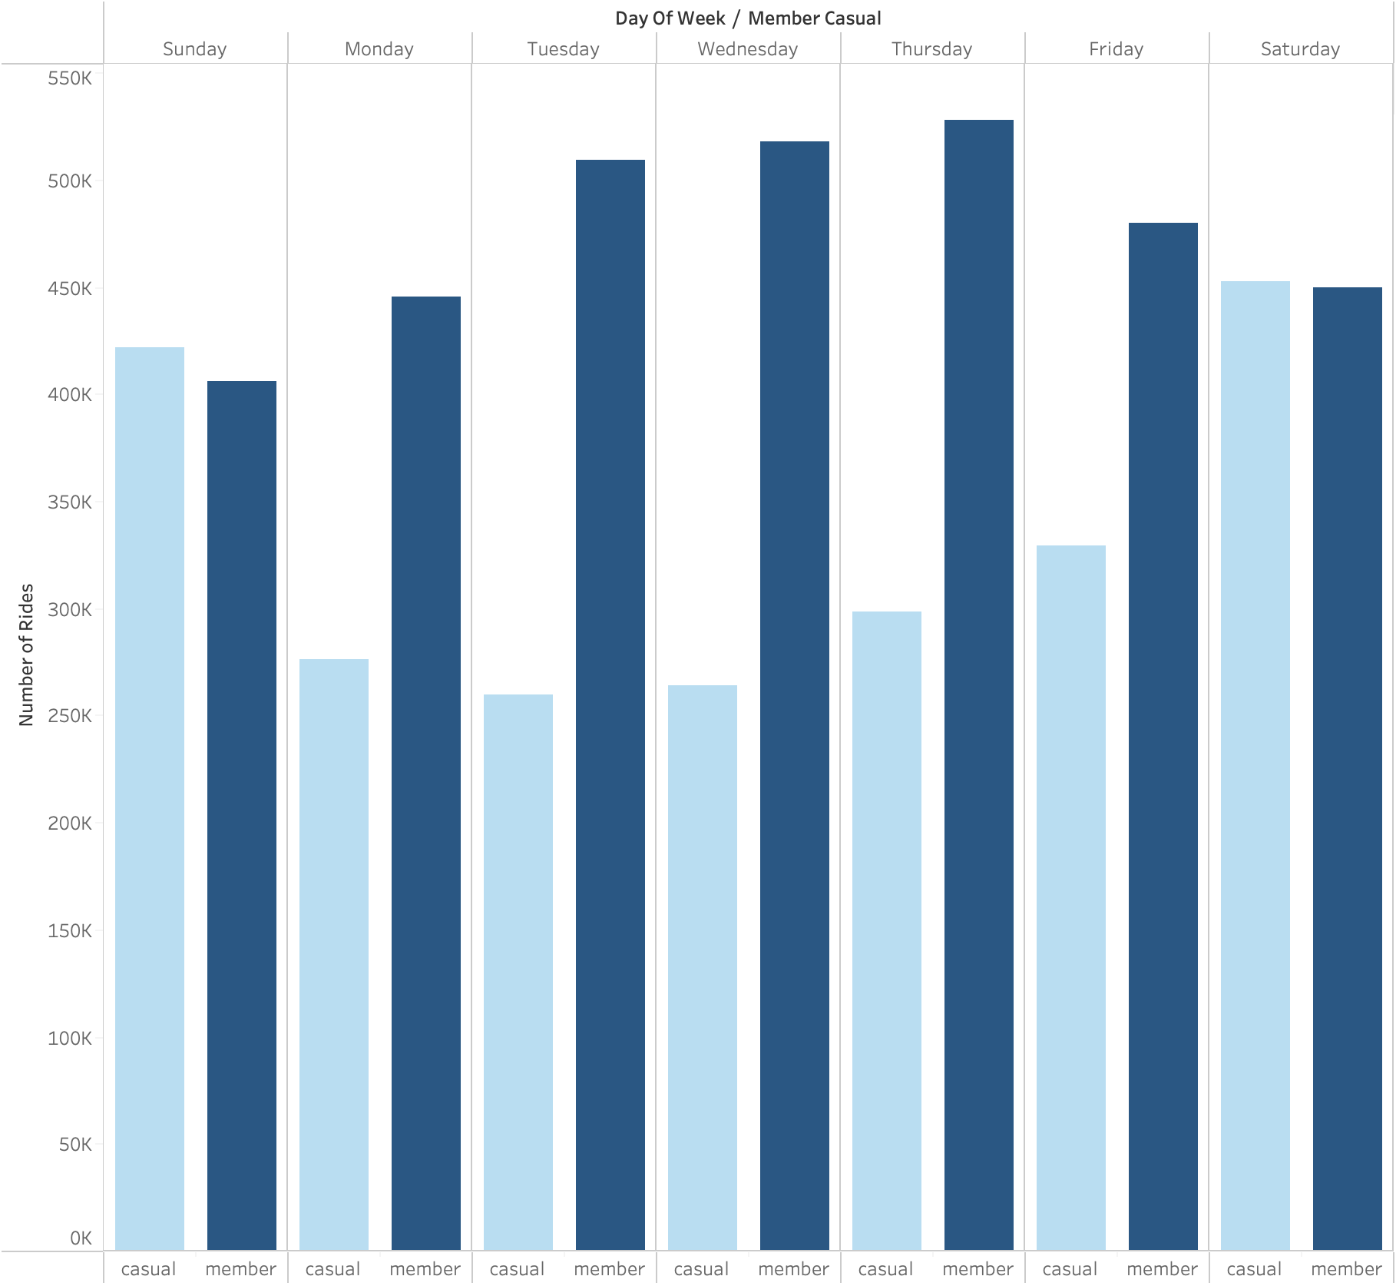
Number of Rides Per Day of the Week
The number of rides taken by members is fairly consistent throughout the week
Casual Riders show a clear increase in the volume of rides during the weekends, suggesting they are mostly done for leisure purposes
Members have a higher volume of rides during the week, suggesting that they are related to work commute

Slide 13
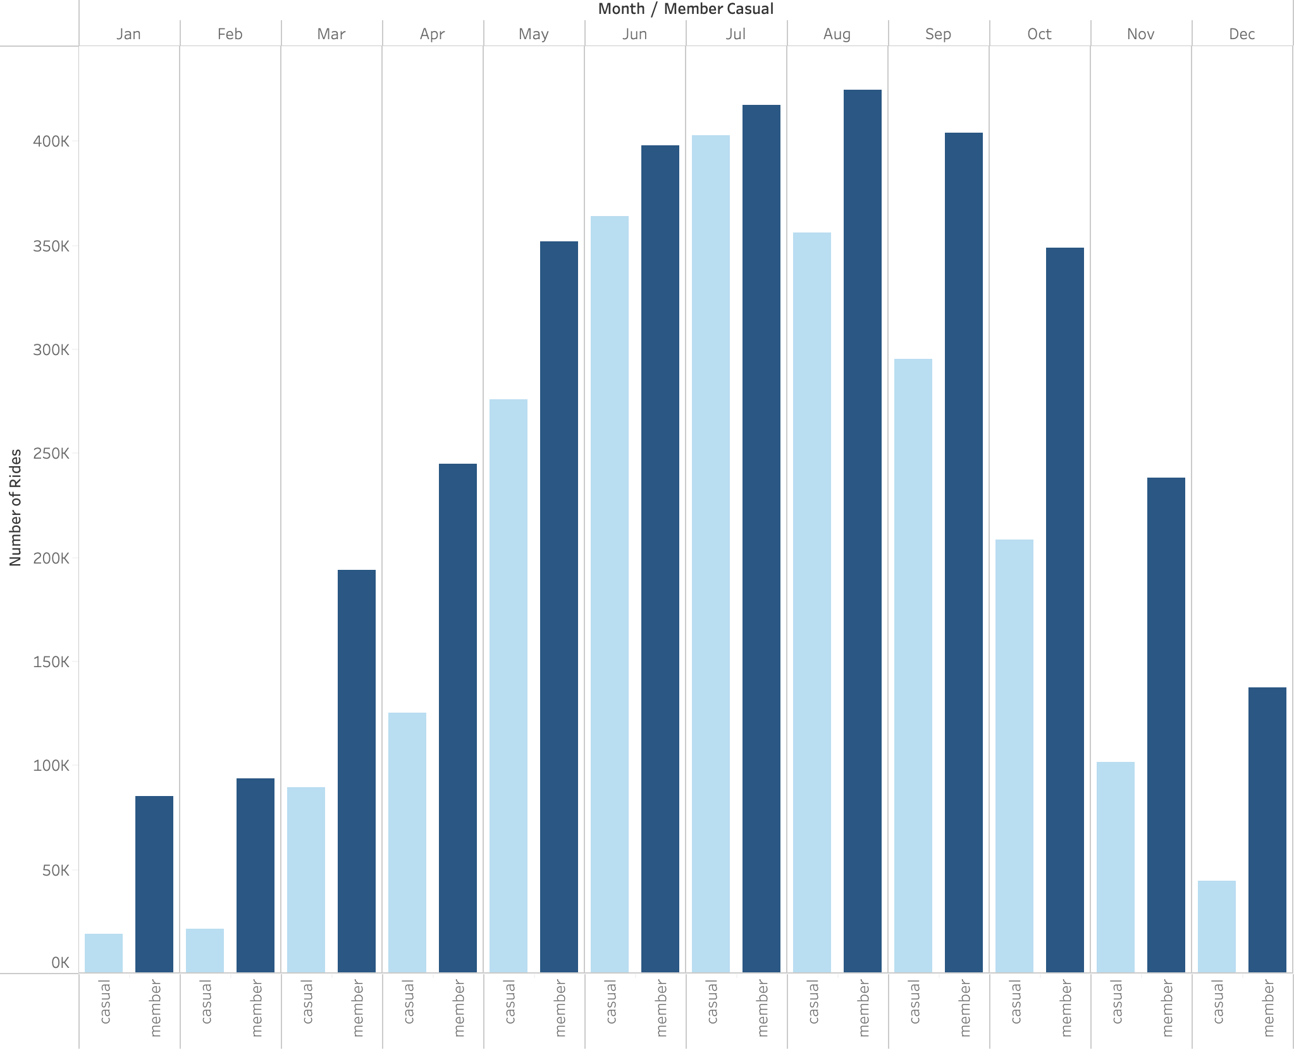
Number of Rides Per Month
Significant decrease in the amount of rides from November – April for both types of riders. Possibly due to the winter conditions in the city
Increase in the amount of rides for Casual Riders during the summer months (June – August)
The amount of rides for Members is fairly consistent from May-October

Slide 14
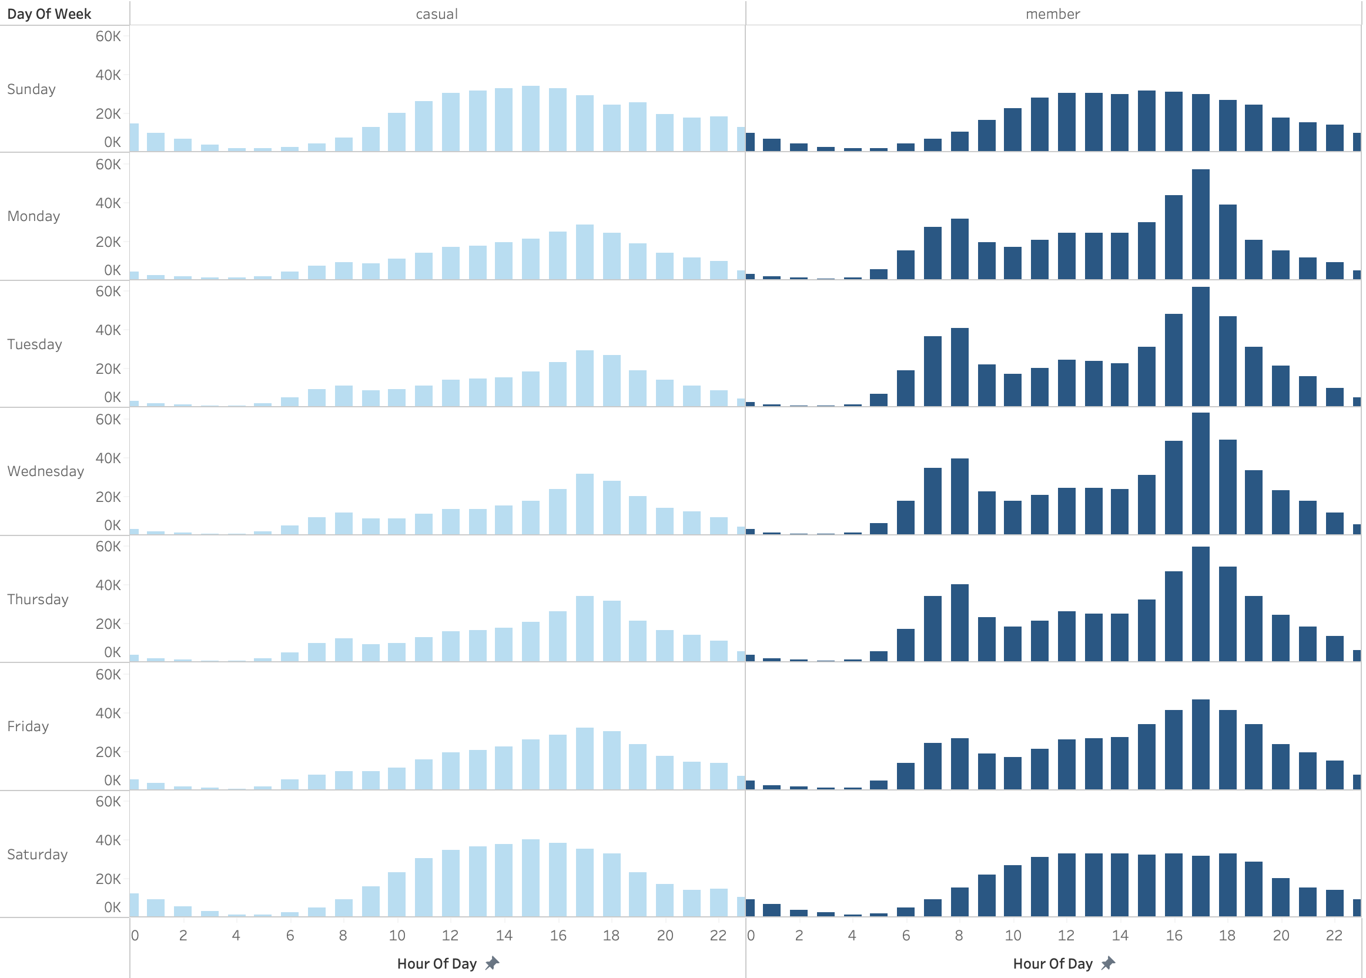
Number of Rides per Hour per Day of the Week
For members, there is a clear pattern on weekdays, where the highest peaks occur between 6 a.m. and 9 a.m., as well as between 4 p.m. and 7 p.m.
During the weekend, both types of riders have a fairly even distribution of rides between 10 a.m. and 7 p.m.
During the week, there is a significant drop in ride volume for Casual Riders with the peaks occurring after 5 p.m.

Slide 15
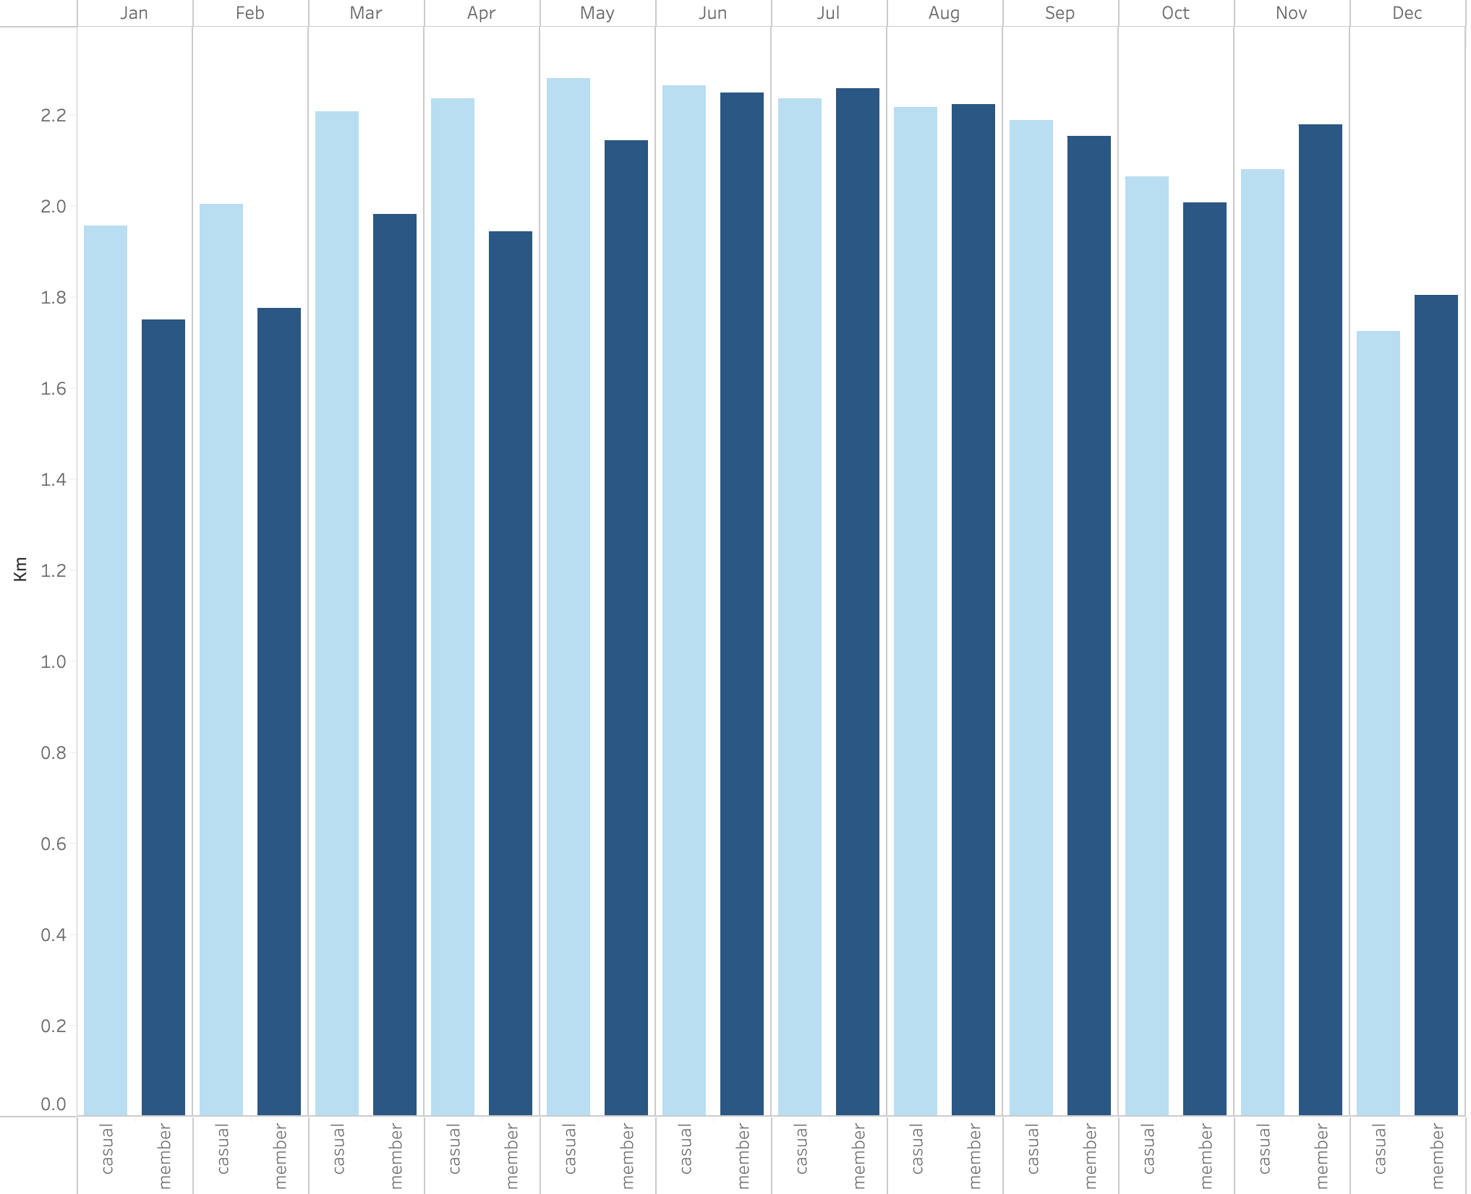
Average Distance Traveled per Month
Members have a greater average distance traveled in July, August, November, and December
The average distance traveled is pretty consistent throughout the year for both types of riders

Slide 16
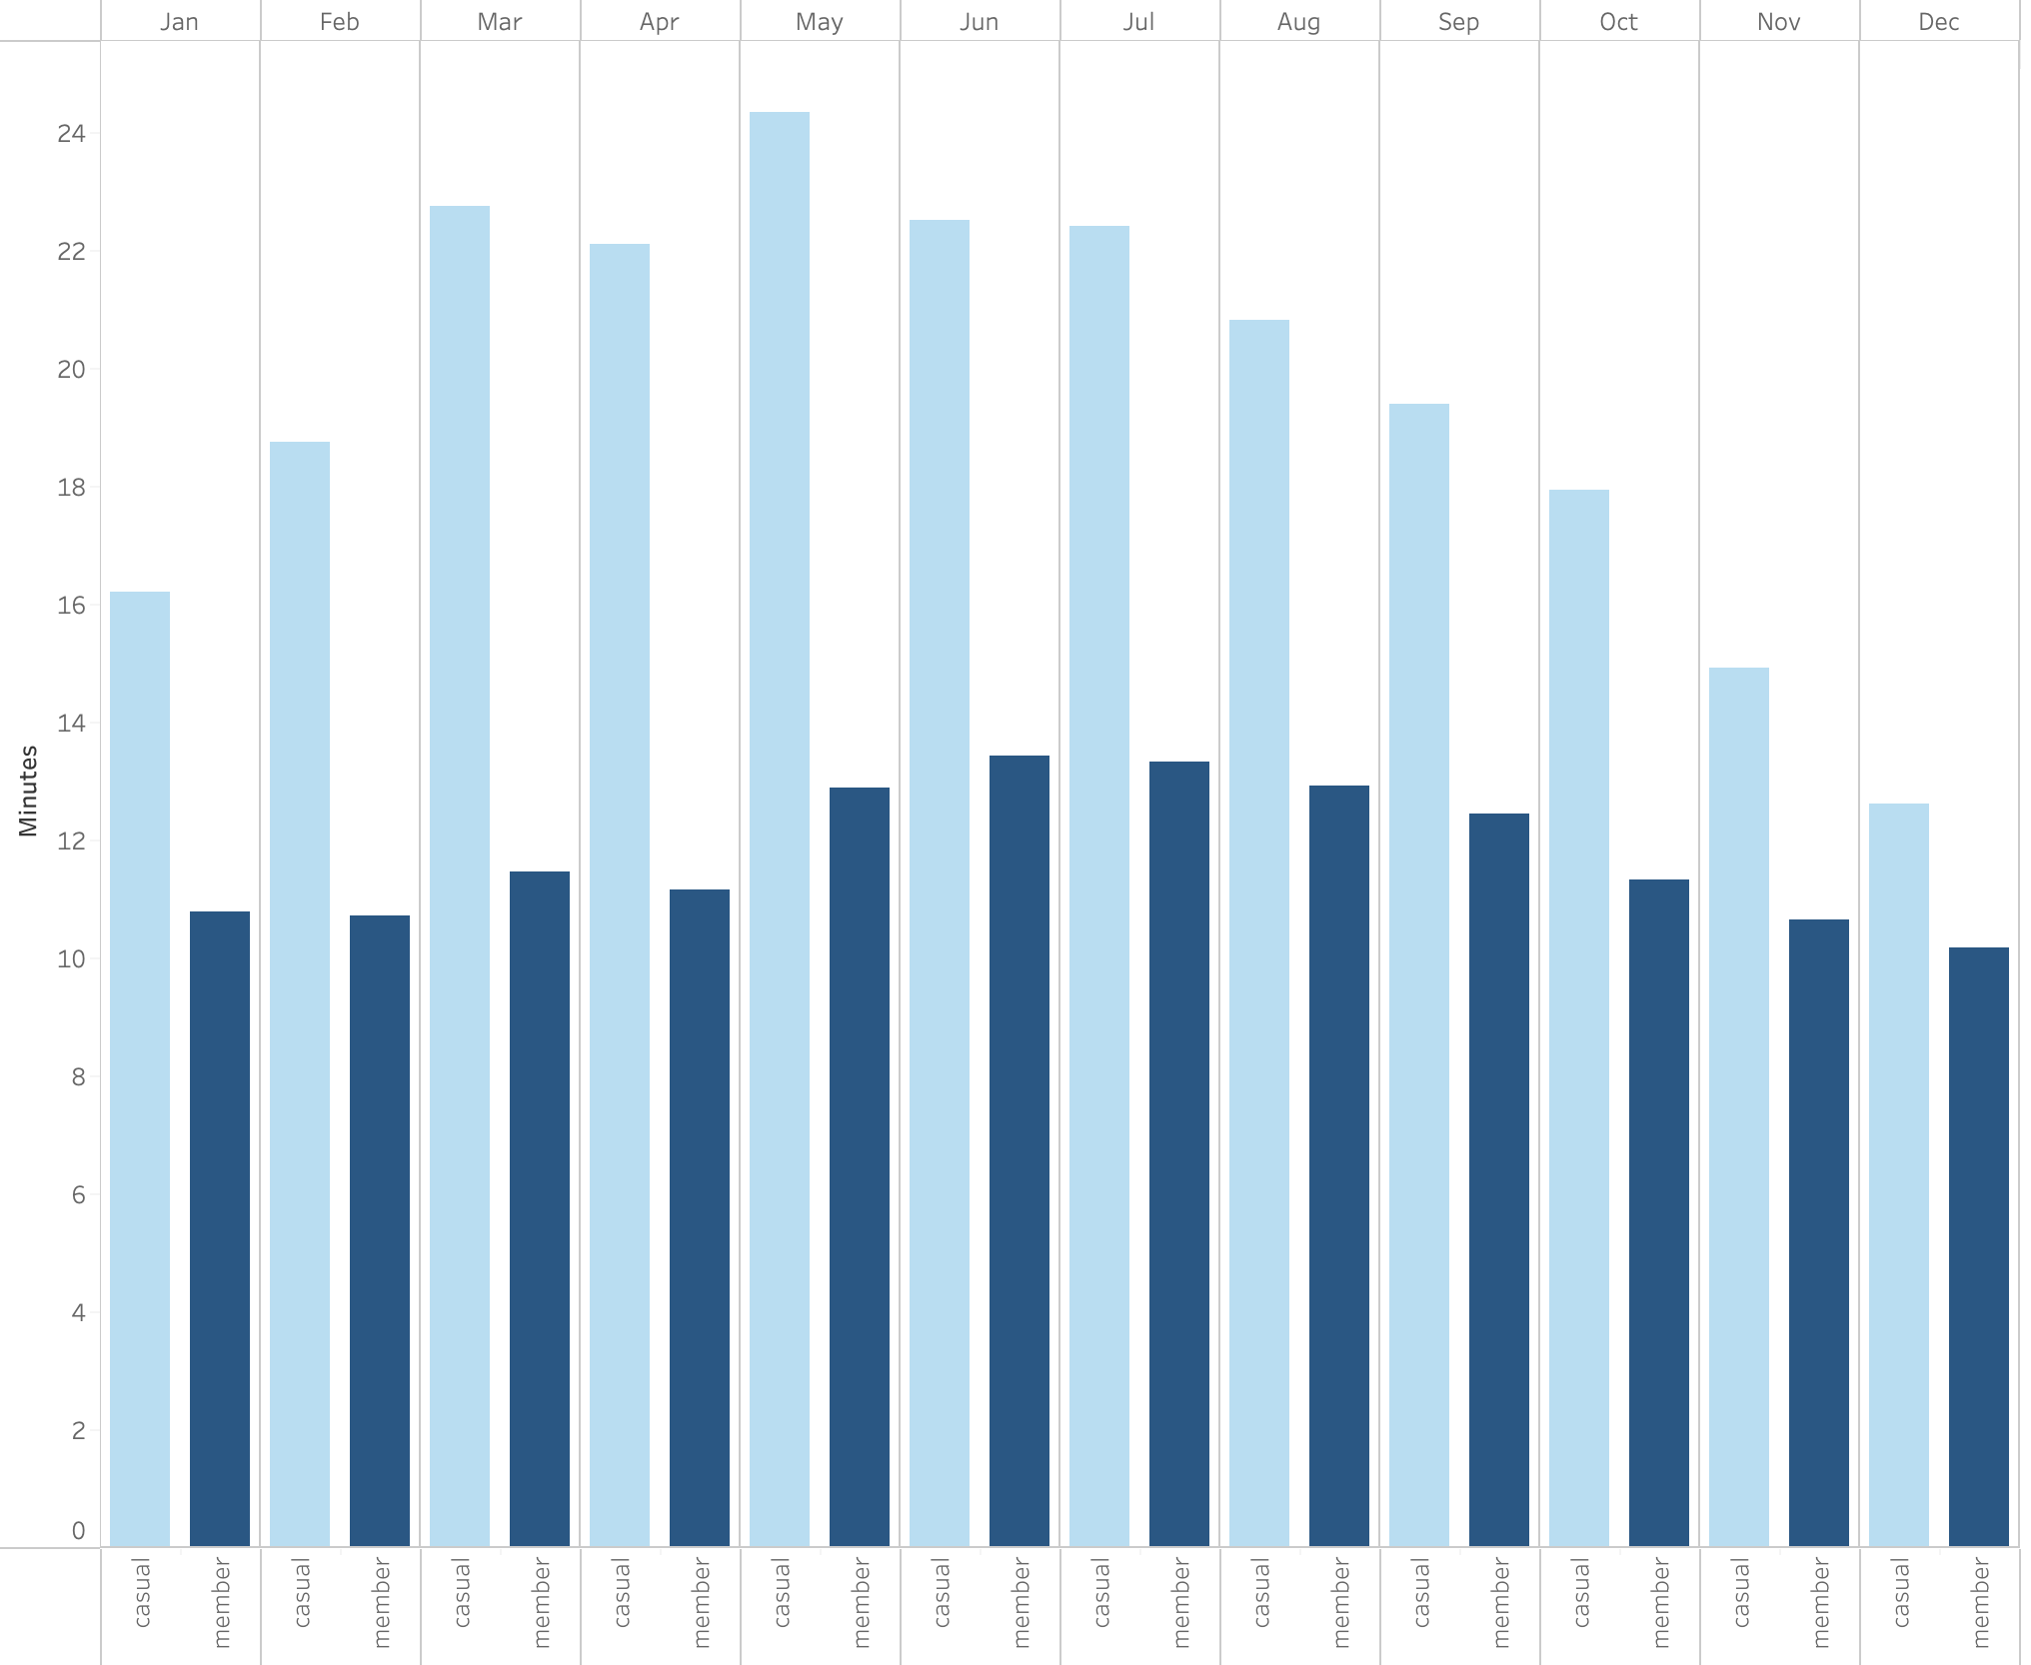
Average Ride Length per Month
The ride length in minutes is considerably higher for Casual Riders throughout the year
The ride length for Members is consistent throughout the year
The ride length for Casual Riders is lower during the winter months
Considering that the distance traveled between both types of riders is pretty similar, but there is such a significant difference between the ride length, it can be deduced that, in general, Casual Riders go slower, which is consistent with leisure rides

Slide 17
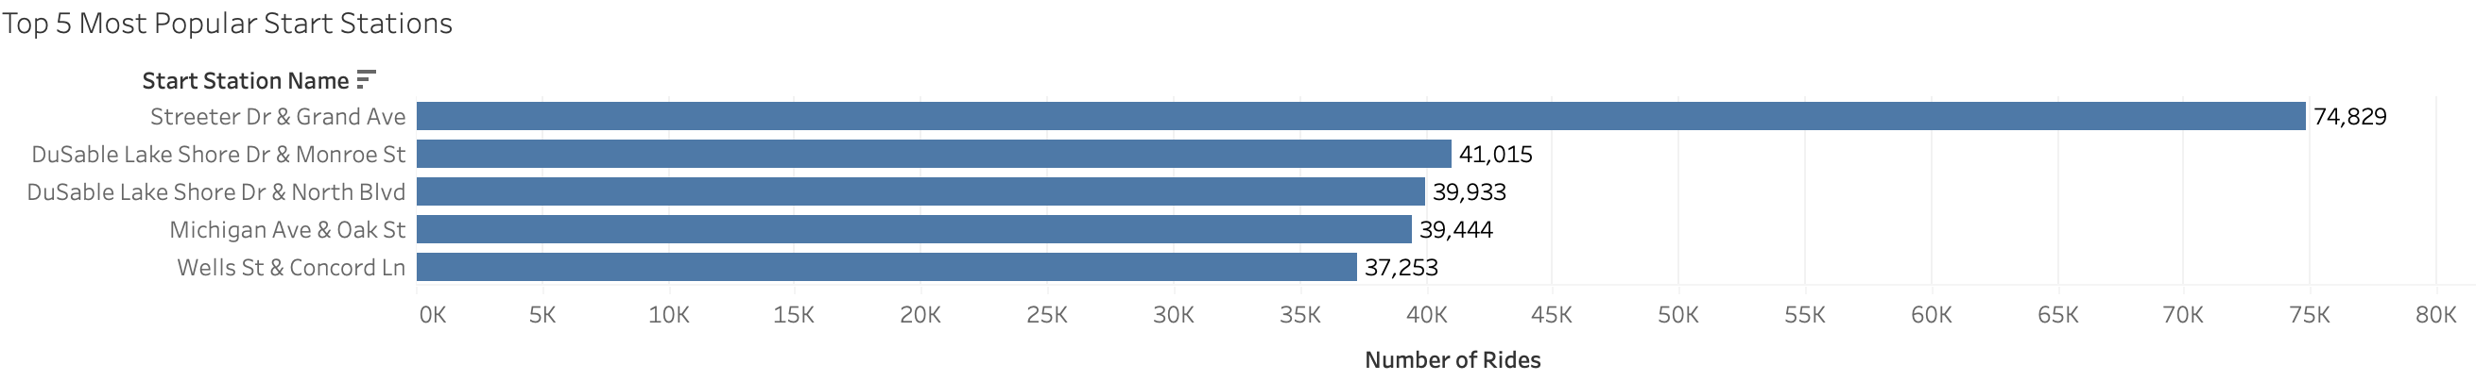
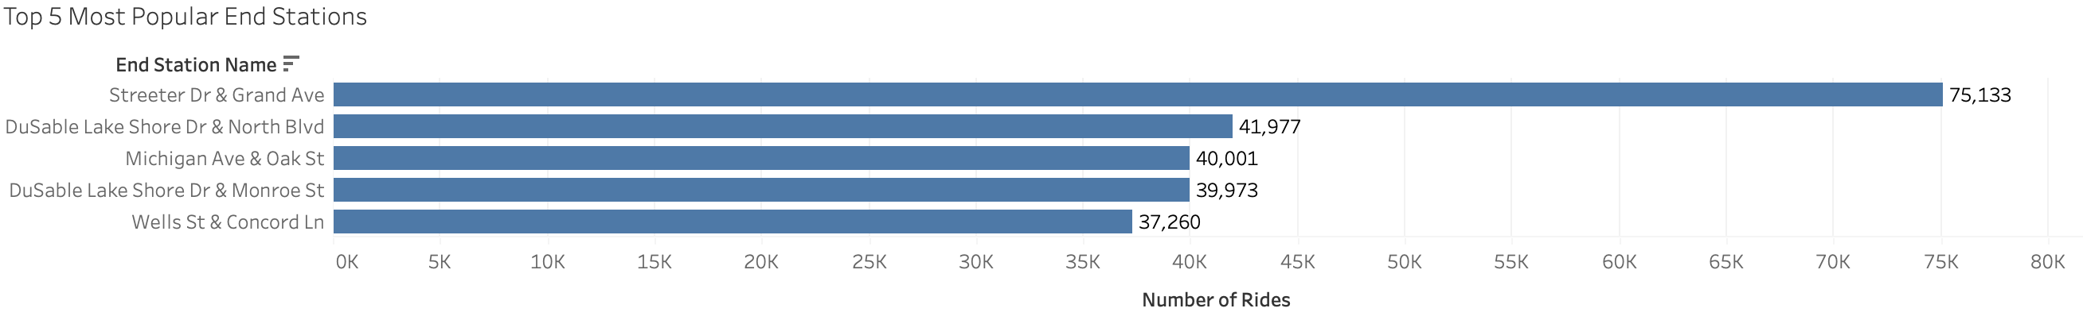
Top 5 Most Popular Stations
The top 5 most popular start and end stations are the same ones but in different order
There is a clear preference for the station with the name “Streeter Dr & Grand Ave”

Slide 18
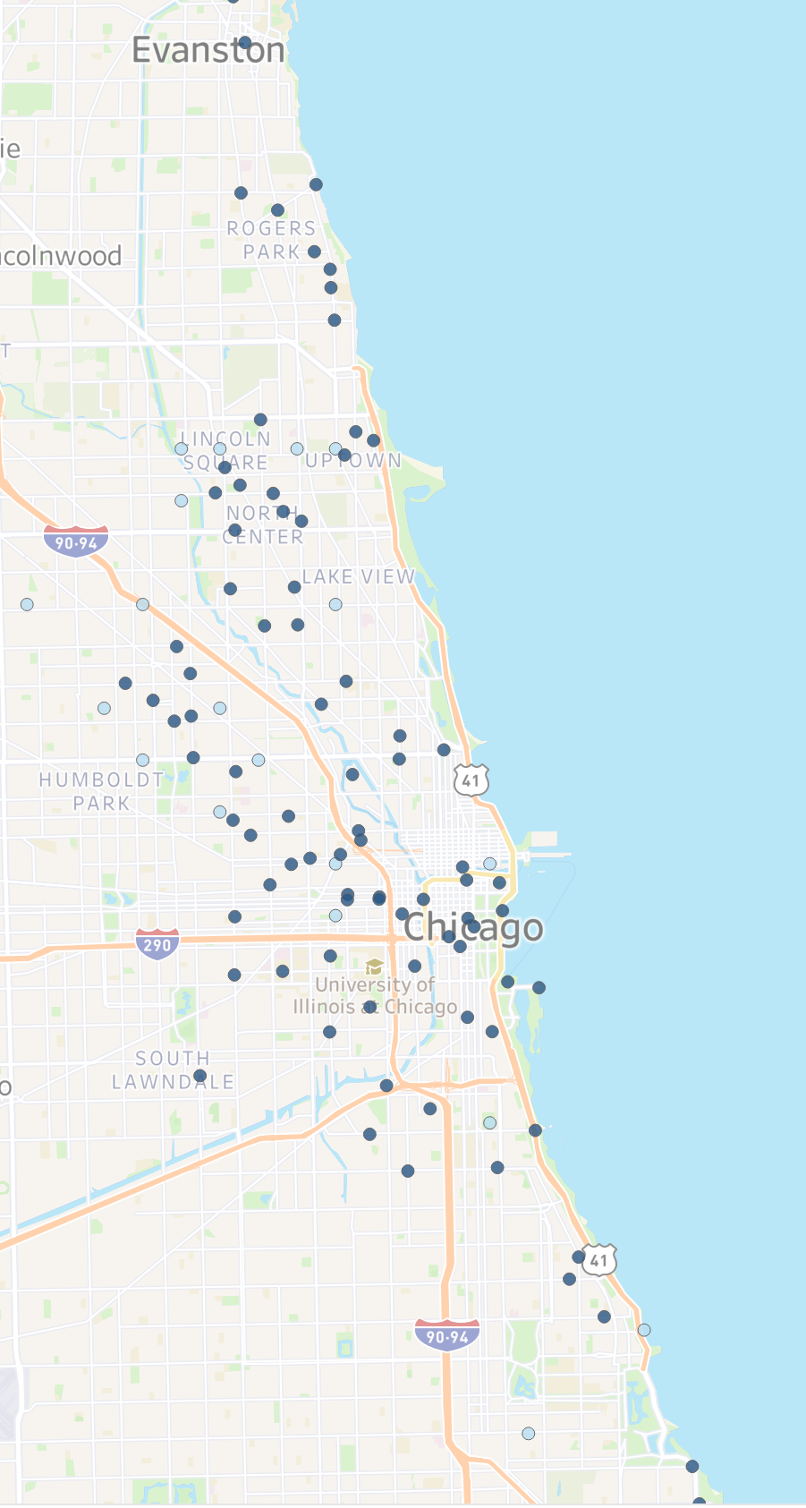
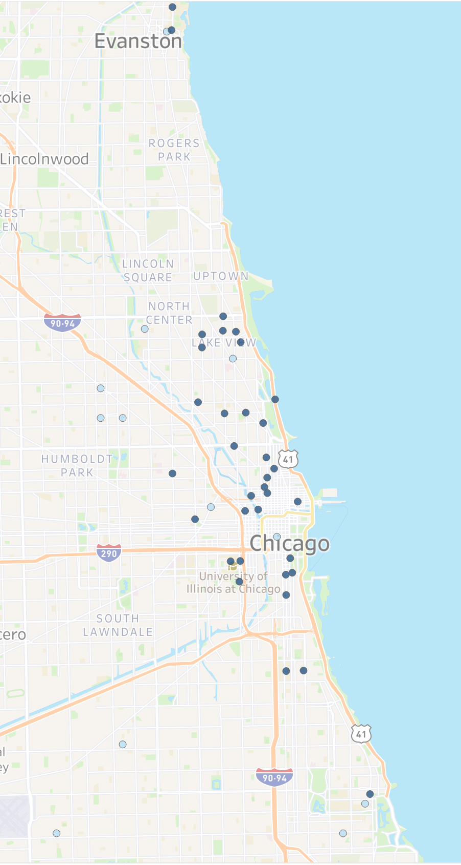
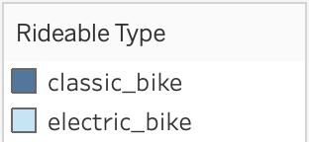
Geography of Rides
Members
Casual Riders
Members utilize a significantly larger number of stations that record a minimum of 75 rides each
Electric bicycles are predominantly employed for rides in the city's outskirts.
Most of the stations that record a minimum of 75 rides for Casual Riders are located downtown and near the bay

Slide 19
What did we learn?

Slide 20
Key Insights
Members account for the biggest proportion of rides (59.17% compared to 40.83%)
Throughout the entire year, the amount of rides taken by Members is greater
On weekdays, members exhibit a distinct pattern during the hours with the highest ride volume.
The average ride distance covered for both types of rides is very similar and consistent throughout the year
There are more riders in the afternoon than there are in the mornings
The month of the year is an important factor that impacts the amount of rides and the duration of the rides

Slide 21
Conclusions and differences between riders
Members prefer to ride during the week while Casual Riders show a clear preference for riding during the weekends
While the average distance traveled was similar, there was a clear difference between the ride length of Casual Riders and Members, with Casual Riders exhibiting significantly higher ride lengths. This is consistent with leisure activity performed by Casual Riders
Members use the bikes in more fixed routines, reflected by the amount of start stations that have at least 75 rides, while Casual Riders show more distinct activities.
Casual Riders mostly use the stations located within the city’s center and bay areas, while Members show a more scattered distribution throughout the city.
Members prefer casual bikes while Casual Riders prefer electric bikes.
Casual riders are the only ones using the docked bikes.

Slide 22
What can I do with this information?

Slide 23
Recommendations & Actionable Steps
Offer different types of memberships. Since casual riders prefer riding on the weekends, and there is a significant difference in the amount of rides taken during the winter months compared to the rest of the year, monthly memberships or weekend-only annual memberships could help attract a larger amount of Members.
Since the most popular start and end stations are known, marketing ads and campaigns could be targeted to these stations via billboards or posters.
Financial incentives via coupons or discounts could be provided for the usage of electric bikes if the rider has an annual membership. This would be a great incentive for casual riders to join since they already prefer electric bikes, and it could be an incentive for current members to transition to electric bikes.

